Slide 1



ISDOH Training:
Systemic Determinants of Health
Module V

Slide 2

Purpose and Learning Objectives
This module provides definitions of the systemic determinants of health within and across tribal and urban Indian communities.
At this end of this module, attendees will be able to:
Recognize the impact of systemic determinants on American Indian and Alaska Native communities.
Apply the concept of systemic determinants to public health topics within American Indian and Alaska Native communities using case study examples.
Define the role tribal sovereignty, tribal public health governance, and Federal policy have on health for American Indian and Alaska Native communities.

Slide 3

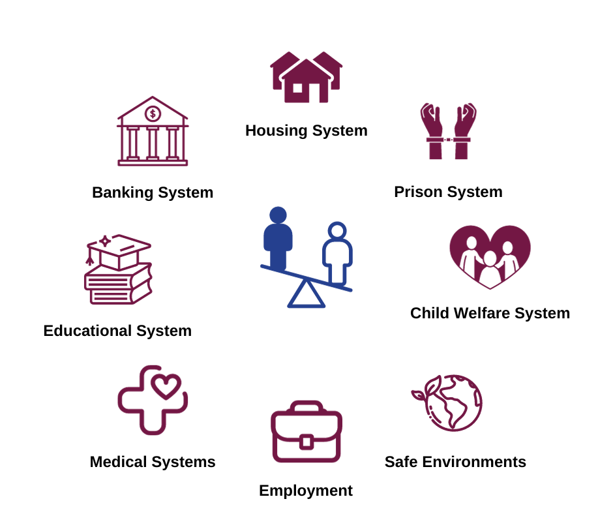
Systematic Determinants of Health
Systemic determinants of health refer to the discrimination that occurs within and across macro-level systems that affect health – for individuals, families, and communities.
One example is structural racism – the effect of not having equitable access to goods or services or being denied human rights based on race.
These experiences impact health through increasing stressors at many levels (Dennis et al., 2021; Veterans Affairs, 2023).

Slide 4
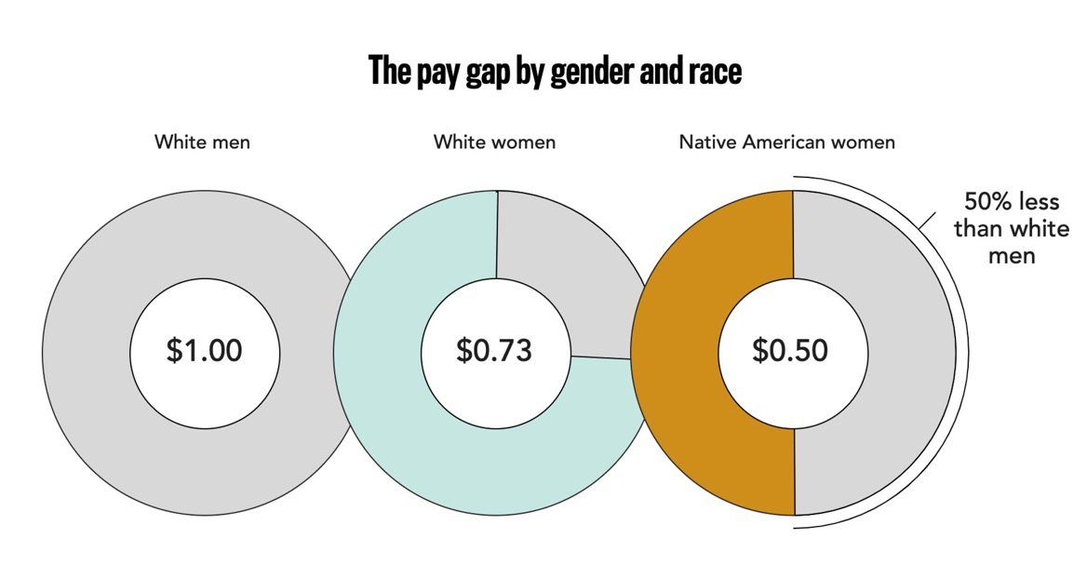
Systemic DOH Affecting AIAN Communities
We see evidence of these systemic determinants of health across multiple systems.
The inequity in pay persists, even within occupations.
This suggests the effect of persistent, systemic inequity based on race.
Native American women face a pay gap—and that’s part of a much bigger problem. (n.d.) Lean In. Retrieved August 10, 2022, from https://leanin.org/data-about-the-gender-pay-gap-for-native-american-women#!

Slide 5
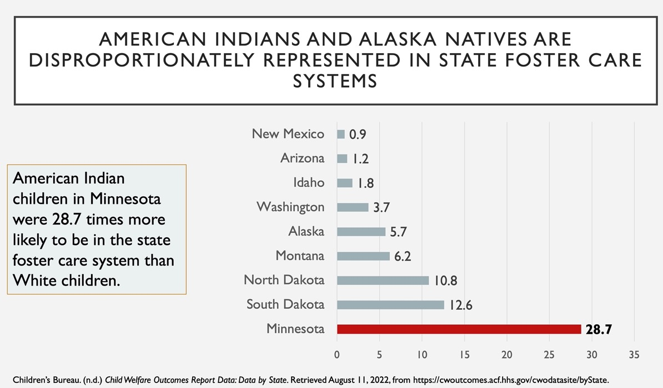
Systemic DOH Affecting AIAN Communities
American Indian and Alaska Native children are significantly more likely to be removed from their families as compared to white children.
This suggests child removal based on race across multiple systems.

Slide 6

A Systems Approach to Systemic Determinants
Tribal sovereignty offers tools like public health governance to address the systemic inequities experienced by American Indians and Alaska Natives.
Tribal housing, employment opportunities, schools, and many other programs provide tribal members with needed support to fully access basic human rights and services.

Slide 7

Critical Thinking Activity: Wayfinding
This activity provides an adapted wayfinding approach to developing a useable guide for community members to improve access to tribal and urban Indian health systems and other key community services.
Refer to "Module IV, Part 1" worksheet for activity details
Imagine you are newly diagnosed with diabetes (or chose another health issue if preferred). What are some of the challenges to accessing needed services you might face?
Discussion Questions – chat with your team about how you would address these questions:
How would tribal or urban Indian community members find their way to access a particular service?
What are some of the system-level challenges in accessing these services?
How can public health and other agencies help community members access these services?

Slide 8
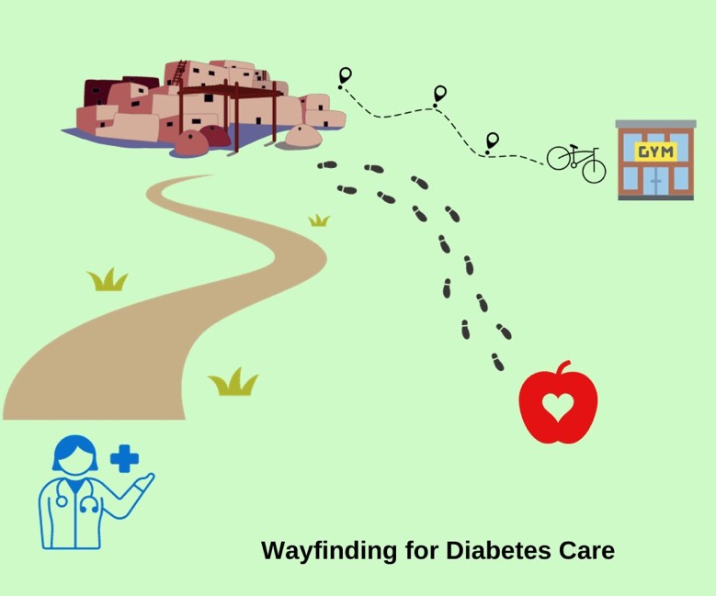
Critical Thinking Activity: Wayfinding (continued)
Why do we use Wayfinding?
A wayfinding approach includes developing a guide for “spatial navigation” to help community members identify where they need to go to achieve their goals (Butler et al., 2023; O’Connor, 2019).
It could be as simple as providing a map of the dialysis clinic (a community-level ISDOH) to improve access to diabetes care (an individual-level SDOH). It could also be complex, with multiple routes to address issues like support of community members after receiving a diabetes diagnosis.

Slide 9
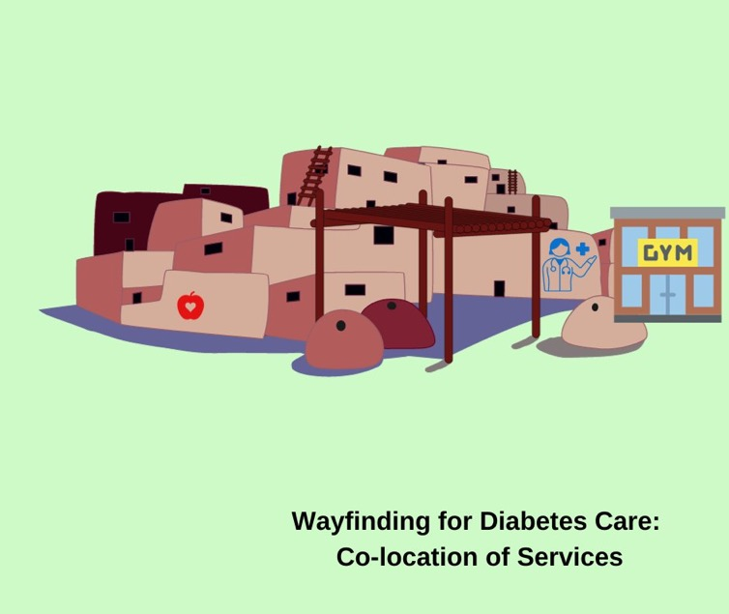
Critical Thinking Activity: Wayfinding (continued)
By mapping these services and relating them to a holistic approach to health through the identification of ISDOH and how these factors function across a given tribal system, we can see a strategy for leveraging knowledge of ISDOH to improve Indigenous Structural Determinants.
How do we ensure meaningful access to needed services? What policies or practices can be put in place to address the systemic determinants of health that may be at play?
In this example, co-location of services can reduce patient burden and improve access to services.

Slide 10

Post-Module Reflection
What were your thoughts about the discussion on Systemic Determinants of Health and doing the Wayfinding exercise?
How has your perspective shifted AFTER this module, if at all?
How will you apply this information to your current work?
Can you identify some things you will do differently after participating in this module?

Slide 11

Summary
This module includes the background and definitions of systemic determinants of health within AIAN communities.
Attendees had an opportunity to apply a Wayfinding map approach to understand access to care for their community.
Module VI will review the previous five modules with the aim of identifying SDOH and ISDOH priorities that can be addressed and reviewed annually to improve health and well-being of individuals, families, and communities.

Slide 12
Bibliography
Children’s Bureau. (n.d.) Child Welfare Outcomes Report Data: Data by State. Retrieved August 11, 2022, from https://cwoutcomes.acf.hhs.gov/cwodatasite/byState.
Butler, J., Holden, K., Lidwell, W. (2023). Universal Principles of Design, Updated and Expanded Third Edition. Rockport Publishers.
Dennis, A. C., Chung, E. O., Lodge, E. K., Martinez, R. A., & Wilbur, R. E. (2021). Looking Back to Leap Forward: A Framework for Operationalizing the Structural Racism Construct in Minority and Immigrant Health Research. Ethnicity & Disease, 31(Suppl), 301–310. https://doi.org/10.18865/ed.31.S1.301
Lean In. (n.d.) Native American women face a pay gap—and that’s part of a much bigger problem. Retrieved August 10, 2022, from https://leanin.org/data-about-the-gender-pay-gap-for-native-american-women#!
O’Connor, M. R. (2019). Wayfinding: the science and mystery of how humans navigate the world (First edition.). St. Martin’s Press.
U.S. Department of Veterans Affairs. (2023). Passport to Whole Health, Chapter 19. Accessed November 13, 2023. https://www.va.gov/wholehealthlibrary/passport/chapter-19.asp

Slide 13
Citation
Parker, M., Largo, D., Benally, T., Oré, C.E. (2023). Indigenous social determinants of health: training modules. University of Washington: Seven Directions. [link to website pdf]

Slide 14

Acknowledgments
This project is supported by the Centers for Disease Control and Prevention (CDC) of the U.S. Department of Health and Human Services (HHS) as part of a financial assistance award to the National Network of Public Health Institutes (NNPHI) totaling $375,000 with 100 percent funded by CDC/HHS (Award #s 1 NU38OT000303-01-00, 5 NU38OT000303-04-00, and 5 NU38OT000303-03-00). NNPHI has collaborated with Seven Directions at the University of Washington, and the CDC’s Office of Tribal Affairs and Strategic Alliances, on this effort.

