Slide 1

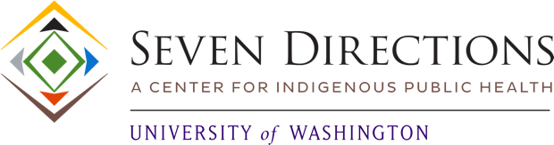

ISDOH Training: Indigenous Social Determinants of Health
Module III

Slide 2

Purpose and Learning Objectives
This module supports the defining and applying Indigenous Social Determinants of Health (ISDOH) to public health and health-related work. The activities provide attendees with an opportunity to identify and describe ISDOH in their own community.
Learning Objectives:
At the end of this module, attendees will be able to:
Define the term Indigenous Social Determinants of Health (ISDOH)
Connect the ISDOH factors with specific American Indian and Alaska Native communities
Recognize that an ISDOH framework can address unique cultural and contextual needs and present their effect on health and wellness for American Indian and Alaska Native communities.
Describe how to use an ISDOH framework to conduct assessment, develop programs, and advocate for policies (tribal, county, state, federal).

Slide 3

What are Indigenous Social Determinants of Health?
"Indigenous Social Determinants of Health are the conditions
specific and unique to Indigenous communities
that impact health and well-being."
(Carroll et al., 2022)
Indigenous Social Determinants of Health are holistic, interconnected, and community centered. Several characteristics of our communities can inform our definitions of Indigenous Social Determinants of Health:
What is the community context? What are the historical and contemporary events that affect our health?
What aspects of our respective cultures inform our health and the health of our community?
Tribal sovereignty offers an important tool to address public health issues. What role does it play in informing our community's health?
There are 576 American Indian and Alaska Native Nations, Tribes, Pueblos, and Villages recognized in the U.S. Each Native nations has its own history, culture, traditions, kinship, lands, and relationship to them. Major domains of Indigenous social determinants of health include Indigenous Knowledge, Language & Identity, Land & Kinships, and Sovereignty & Governance.

Slide 4
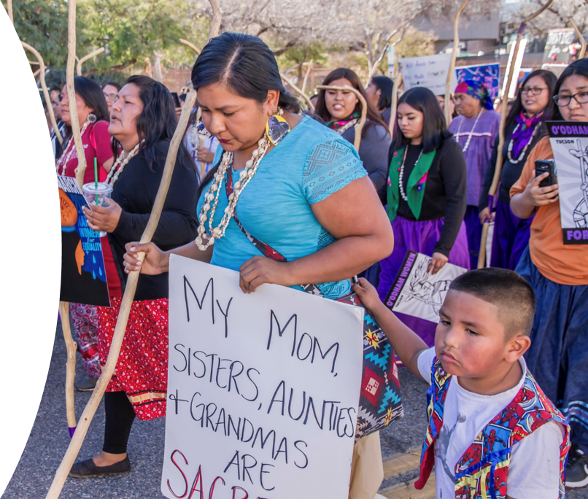
Indigenous Knowledge
Indigenous Knowledge varies by region and culture.
Indigenous Knowledge could include:
Ways to process, understand, teach, and take collective action for various causes and policies (Gone, 2019).
Ways to be in community, including, but not limited to, benefiting from prayer, mutual aid, togetherness, cultural connectedness, and other shared experiences that support wellness (Straits, 2020).

Slide 5
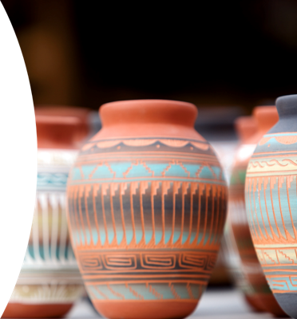
Language and Identity
Language and identity vary across regions and cultures.
Language and identity could include:
Speaking Indigenous languages with other speakers, passing on and practicing cultural teachings, engaging in practices that support collective identity (Gonzalez et al., 2021).
Revitalizing and growing Indigenous language use; reclaiming traditional knowledge, beliefs, and practices; finding ways to support community in maintaining and growing cultural connection opportunities (Jacob et al., 2019).

Slide 6
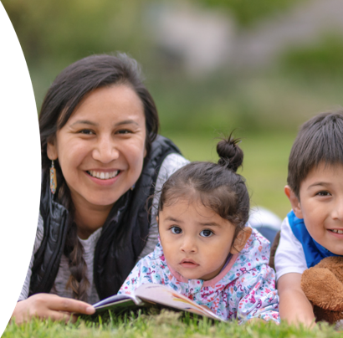
Land and Kinship
Understandings of land and kinship differ across tribal communities. Constructs of land and kinship could include:
Connection to the geography of a people and to one another (Greenwood & Lindsay, 2019).
Recognizing and reaffirming Indigenous peoples are rooted in traditional understandings of specific places, be it land-, water-, or ice-based locations (Walters et al., 2020).
Traditional stories, Indigenous language names for locations and landmarks, and traditional ways of being with and respecting the land and environment (Hodge et al., 2022).

Slide 7
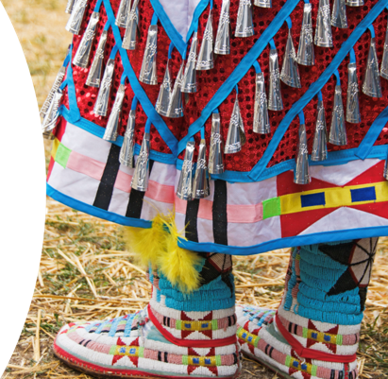
Sovereignty
Tribal sovereignty may be expressed differently across tribal communities. It may include:
Sovereign rights of tribal governments to ensure healing, health, welfare, and safety of their people and ancestral lands (Mays, 2022).
Governance practices, both current and traditional, that support wellness for individuals, families, communities, and the environment around us (Rasmus et al., 2020).

Slide 8

Applying Indigenous Social Determinants to Community Health
American Indian and Alaska Native communities have been in contact with Europeans for over 500 years.
The forces of colonization have had an indelible impact on Native populations, cultures, languages, and access to traditional lands and resources.
Our Indigenous understandings, practices, and beliefs have been retained through hard fought efforts to maintain languages, preserve cultural and community connections, sustain relationships and supports, and protect and sustain our connections to our lands and other living beings that are part of our shared environments.

Slide 9

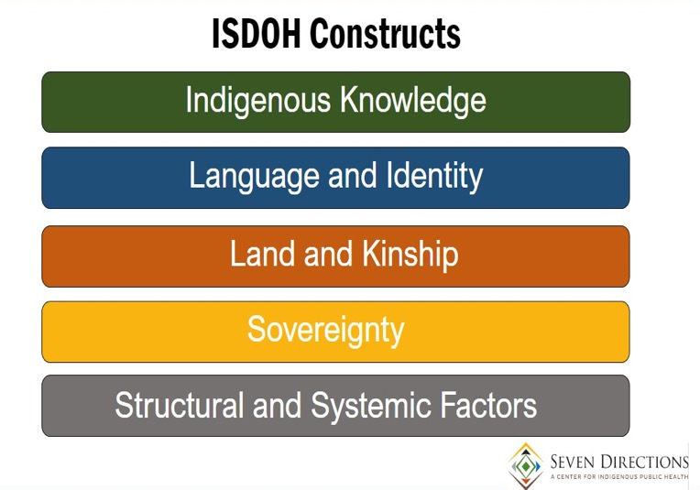
Explore and Apply Indigenous Social Determinants
Discuss the following questions:
How would you describe/define these ISDOH?
How are these domains operating in your tribal community?
What trends do you see? What stands out?
What issues can be addressed by your team or program?
What strategies can be used to improve one ISDOH within your/a tribal community? How could you measure the impact of this improvement?
Refer to Module III, Part 1 worksheet

Slide 10

Activity: Think, Pair, Share
Instructions:
With your team, draw a map or diagram of the ISDOH important in your community.
Use the ISDOH constructs as a guide for your discussion and mapping process.
Consider if there are additional ISDOH that need to be included in your map.
Refer to Module III worksheet for additional activities

Slide 11

Post-Module Reflection
What were your thoughts having gone through the ISDOH Mapping exercise?
How has your perspective shifted AFTER this module, if at all?
How will you apply this information to your current work?
Can you identify some things you will do differently after participating in this module?

Slide 12

Summary
Module III provided background and definitions of Indigenous social determinants of health as described in peer-reviewed literature and Our Stories, Our Journeys.
These ISDOH constructs provide ways to identify them in community contexts.
This module also supported important discussions about ISDOH and their impact on community health.
Module III will provide a definition and foster further discussion about various structural and systemic factors that are attributed to the well-being in American Indian and Alaska Native nations and communities

Slide 13
Bibliography
Carroll, S. R., Suina, M., Jäger, M. B., Black, J., Cornell, S., Gonzales, A. A., Jorgensen, M., Palmanteer-Holder, N. L., De La Rosa, J. S., & Teufel-Shone, N. I. (2022). Reclaiming Indigenous health in the US: Moving beyond the Social Determinants of Health. International Journal of Environmental Research and Public Health, 19(12), 7495–. https://doi.org/10.3390/ijerph19127495
Gone, J. P. (2019). “The Thing Happened as He Wished”: Recovering an American Indian cultural psychology. American Journal of Community Psychology, 64(1-2), 172–184. https://doi.org/10.1002/ajcp.12353
Gonzalez, M. B., Sittner, K. J., Saniguq Ullrich, J., & Walls, M. L. (2021). Spiritual connectedness through prayer as a mediator of the relationship between Indigenous language use and positive mental health. Cultural Diversity & Ethnic Minority Psychology, 27(4), 746–757. https://doi.org/10.1037/cdp0000466
Greenwood, M., & Lindsay, N. M. (2019). A commentary on land, health, and Indigenous knowledge(s). Global Health Promotion, 26(3_suppl), 82–86. https://doi.org/10.1177/1757975919831262
Hodge, F. S., Pasqua, A., Marquez, C. A., & Geishirt-Cantrell, B. (2002). Utilizing traditional storytelling to promote wellness in American Indian communities. Journal of Transcultural Nursing, 13(1), 6–11. https://doi.org/10.1177/104365960201300102
Jacob, M. M., Sabzalian, L., Johnson, S. R., Jansen, J., & Morse, G. S. (2019). “We Need to Make Action NOW, to Help Keep the Language Alive”: Navigating tensions of engaging Indigenous educational values in university education. American Journal of Community Psychology, 64(1-2), 126–136. https://doi.org/10.1002/ajcp.12374
Mays, V. M., Echo-Hawk, A., Cochran, S. D., & Akee, R. (2022). Data equity in American Indian/Alaska Native populations: Respecting sovereign nations’ right to meaningful and usable COVID-19 data. American Journal of Public Health (1971), 112(10), 1416–1420. https://doi.org/10.2105/AJPH.2022.307043

Slide 14
Bibliography
Rasmus, S. M., Whitesell, N. R., Mousseau, A., & Allen, J. (2020). An intervention science to advance underrepresented perspectives and Indigenous Self-Determination in health. Prevention Science, 21(Suppl 1), 83–92. https://doi.org/10.1007/s11121-019-01025-1
Straits, K. J. E., deMaría, J., & Tafoya, N. (2019). Place of strength: Indigenous artists and Indigenous Knowledge is prevention science. American Journal of Community Psychology, 64(1-2), 96–106. https://doi.org/10.1002/ajcp.12376
Walters, K. L., Johnson-Jennings, M., Stroud, S., Rasmus, S., Charles, B., John, S., Allen, J., Kaholokula, J. K., Look, M. A., de Silva, M., Lowe, J., Baldwin, J. A., Lawrence, G., Brooks, J., Noonan, C. W., Belcourt, A., Quintana, E., Semmens, E. O., & Boulafentis, J. (2020). Growing from Our Roots: Strategies for developing culturally grounded health promotion interventions in American Indian, Alaska Native, and Native Hawaiian Communities. Prevention Science, 21(Suppl 1), 54–64. https://doi.org/10.1007/s11121-018-0952-z

Slide 15
Citation
Parker, M., Largo, D., Benally, T., Oré, C.E. (2023). Indigenous social determinants of health: training modules. University of Washington: Seven Directions. [link to website pdf]

Slide 16

Acknowledgments
This project is supported by the Centers for Disease Control and Prevention (CDC) of the U.S. Department of Health and Human Services (HHS) as part of a financial assistance award to the National Network of Public Health Institutes (NNPHI) totaling $375,000 with 100 percent funded by CDC/HHS (Award #s 1 NU38OT000303-01-00, 5 NU38OT000303-04-00, and 5 NU38OT000303-03-00). NNPHI has collaborated with Seven Directions at the University of Washington, and the CDC’s Office of Tribal Affairs and Strategic Alliances, on this effort.

