Slide 1



ISDOH Training: Social Determinants of Health
Module II

Slide 2

Purpose and Learning Objectives
This module explores the background, definitions, and application of the Social Determinants of Health (SDOH) in public health practice to achieve the goals of social and health equity.
This module provides activities and discussion questions to examine the SDOH and consider their applicability within tribal and urban Indian communities.
Learning Objectives:
At the end of this module attendees will be able to:
Define the Social Determinants of Health and discuss the importance to public health practice.
Describe the CDC framework for Social Determinants of Health by using examples.
Apply the Social Determinants of Health framework to tribal and urban Indian communities.

Slide 3

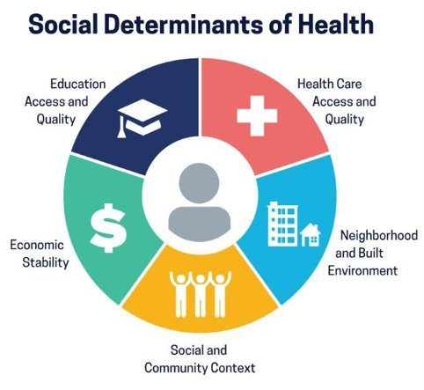
Social Determinants of Health
Social Determinants of Health (SDOH) are:
Non-medical factors and conditions such as where people are born, grow, live, work, and play; and
The influences and systems that share the conditions of daily life (CDC, 2022).
In the U.S., the Centers for Disease Control and Prevention (CDC) based the five domains in their model (right) on two decades of research on the impact of SDOH on health outcomes.
The next five slides provide descriptions and examples of each domain.
(CDC Healthy People 2023, 2020)

Slide 4

Social Determinants of Health Impact Health Equity
Social Determinants of Health are also related to community health. Identifying and understanding how they impact community health can support health equity.
Health equity refers to achieving a fair, anti-racist, or anti-discriminatory distribution of and access to power, resources, and information for all peoples, individuals, communities, and populations to achieve their highest level of health (Braveman & Gruskin, 2003; Willen et al., 2021).
The CDC has developed a definition of SDOH, along with the indicators and measures, for uses within the U.S. public health system (Solar & Irwin, 2010; Healthy People 2023, 2020).

Slide 5
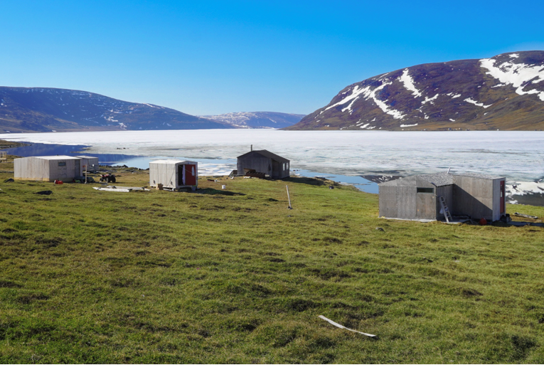
Economic Stability
Economic stability is associated with an individual's ability to ensure that basic needs are met for themselves and their family.
Indicators include income level, employment status, poverty level, food security, and housing stability.
Research has confirmed an association or relationship between social status and health outcomes (Adamsen et al., 2018; Braveman et al., 2010).
Examples of community level instability would be things like the taking of natural resources, limitations on access to economic development opportunities, or the limited employment opportunities in rural areas.

Slide 6

Education: Access & Quality
Education provides an individual with the knowledge and skills to support conditions for improved health and well-being.
High school graduation, enrollment in higher education, language, literacy, early childhood education are important indicators for health.
American Indian and Alaska Native student enrollment is decreasing (Postsecondary National Policy Institute, 2023). Living in low educational attainment areas has been linked to an increased likelihood of being obese for over-age-50 American Indian and Alaska Native community members (Goins et al., 2022).
Educational training supports increased opportunities for employment, which can help improve financial stability and improved health literacy.
Identifying the factors that inhibit or promote entrance, retention, and graduation of American Indian and Alaska Native students represent important social determinants of health.

Slide 7
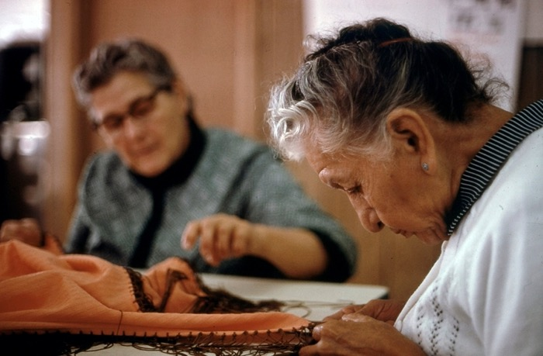
Healthcare: Access & Quality
Access to quality health care ensures individuals receive the care needed to improve and/or maintain their health and well-being.
Indicators can include having: 1) a primary care physician, 2) health insurance, 3) respectful patient – provider relationships, and 4) affordable medications.
While many native nations control their health systems (Hubbard & Chen, 2022; Zuckerman et al., 2004), elders continue to find access to care problematic (Jaramillo & Willging, 2021).
Tribes can address patient satisfaction by providing translation, inclusion of traditional healing, and other community-specific supports needed to improve access to care.

Slide 8
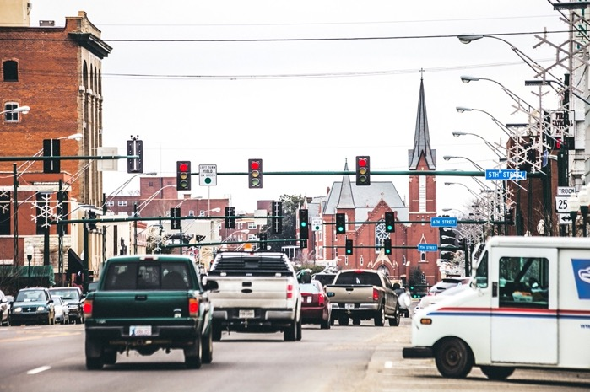
Neighborhood and Built Environment
Neighborhood and the built environment have a significant impact on individual and community health and well-being.
The domains of neighborhood and the surrounding built environment include factors like housing quality, access to transportation, access to clean air and water, healthy food access, and exposure to violence and crime.
Neighborhood characteristics are related to increased risk related to diabetes (Jiang et al., 2018), exposure to COVID-19 (Rodriguez-Lonebear et al., 2020), and access to resources (Chodur et al., 2016) among American Indians and Alaska Natives.

Slide 9
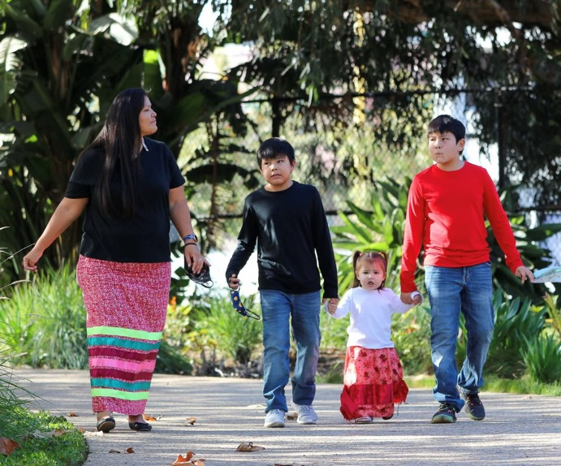
Social and Community Context
Social and Community context refer to the interpersonal relationships and networks that contribute to an individual's health and well-being.
This domain includes factors like community cohesion, civic participation, discrimination, racism, cultural norms, violence, workplace conditions, and incarceration.
Within the context of American Indian and Alaska Native nations and communities, high levels of discrimination are found in health care settings, judicial and law enforcement encounters, and employment contexts (Fingling et al., 2019).

Slide 10
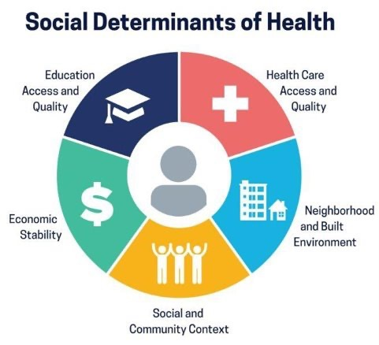
Activity: Think, Pair, Share
Instructions: Take 10-15 minutes, with a partner, to discuss the following questions:
In your own words, how do you define social determinants of health (SDOH)?
Have you seen the term SDOH before this presentation and how was it being applied?
Do you agree with the five domains identified?
Would you add to any areas?
(Healthy People, 2023, 2020)

Slide 11

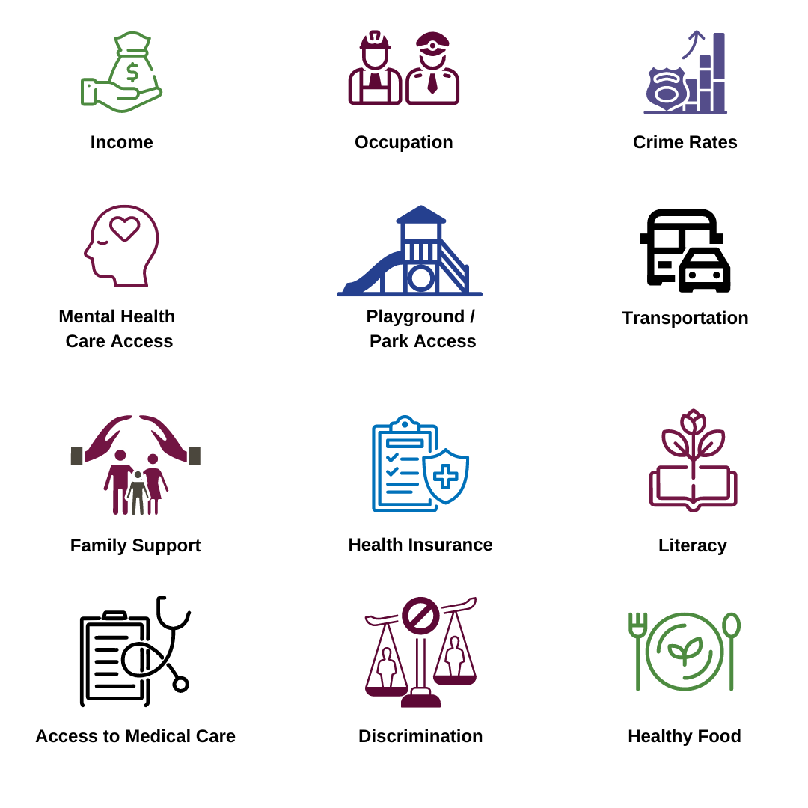
Activity: Think, Pair, Share
Refer to Module II, Part 1 Worksheet for activity details
Instructions:
Connect the Five Domains with Factors: Refer to the image on the screen, and the factors listed on the worksheet.
Use the following prompts for discussion:
Which factors are important for your community?
What factors are important for your community that are not included in this figure?
How do these factors play a role in creating conditions in your community for health and wellness?

Slide 12

Activity: Vignette – Type 2 Diabetes Story
Narrative
Mark lives in a rural community with his wife and two children. The town has a population of 4,000 residents and includes a grocery store, one gas station, a community clinic, and an elementary and high school. Mark’s community is a tight-knit agricultural community. Recently, Mark has been diagnosed with type-2 diabetes. His doctor is a rotating doctor at the community clinic and only sees patients in Mark’s community on Fridays. She has prescribed Mark a personal diet plan and medication to manage his blood glucose level.
Refer to Module II, Part 2 Worksheet for activity details
Instructions - Handout
Read the case-study vignette (10-15 minutes)
Break up in groups of 3-4 for discussion (10-15 minutes)
Share Out (15-20 minutes)

Slide 13

Discussion: Prompt 1
In a 3-4 person group, start discussing the story using the following prompts.
From a social determinants of health perspective, environmental factors create conditions in which people are born, live, learn, and grow.
The environmental conditions we live in contribute to avoidable or preventable health.
With this perspective, what were factors and conditions at the community level that may have led to Mark's diagnosis?

Slide 14
Continuation of Story & Discussion Prompt 2
Narrative continued: A year has gone by, and Mark has been able to manage his diabetes and adopt a new healthy diet with regular exercise.
Community health workers are recording an increase in individuals who have been diagnosed with diabetes in the community.
Discussion Prompt: Describe why an individual-based strategy like a prescribed diet is not sufficient to address the social conditions that are causing an increase in diabetes across the community.

Slide 15
Strategies to Address Social Determinants of Health
Drawing Activity:
Draw two diagrams that explain different approaches to prevent and manage Type 2 Diabetes. Discuss the differences in the two diagrams as well as the similarities.
Prevention of Diabetes: Draw the social determinants of health that could be leveraged to prevent diabetes in your community.
Management of Diabetes: Draw the social determinants of health that could be changed within your setting to improve diabetes management.
Discussion prompts:
What would you do to improve prevention of diabetes in your community?
What would you like to see done to help support management of diabetes in your community?
What strategies can be done immediately?
Which strategies are medium-term goals? Which are long-term goals?

Slide 16

Post-Module Reflection
What were your thoughts about sharing the connection between the CDC five domains for social determinants of health and your community?
How has your perspective shifted AFTER this module, if at all?
How will you apply this information to your current work?
Can you identify some things you will do differently after participating in this module?

Slide 17

Summary
Module II provided definitions and activities for social determinants of health and the CDC domains.
It provided a vignette to think about how SDOH impact the health of the American Indian and Alaska Native community that you and your program serve.
Module III will provide a definition of the Indigenous Social Determinants of Health, ways to identify and describe them, and their impact on health and well-being within American Indian and Alaska Native communities.

Slide 18
Bibliography
Adamsen, C., Schroeder, S., LeMire, S., & Carter, P. (2018). Education, income, and employment and prevalence of chronic disease among American Indian/Alaska Native elders. Preventing Chronic Disease, 15, E37–E37. https://doi.org/10.5888/pcd15.170387
Braveman, P. & Gruskin, S. (2003). Defining equity in health. J Epidemiol Community Health, 57:254–8. doi: 10.1136/jech.57.4.254
Centers for Disease Control and Prevention. (2022-b, December 8). Social Determinants of Health at CDC. Retrieved August 13, 2023, from https://www.cdc.gov/about/sdoh/index.html
Braveman, P.A., Cubbin, C., Egerter, S., Williams, D.R., Pamuk, E. Socioeconomic disparities in health in the United States: what the patterns tell us. Am J Public Health. 2010 Apr 1;100 Suppl 1(Suppl 1):S186-96. https://doi.org/10.2105/AJPH.2009.166082. Epub 2010 Feb 10. PMID: 20147693; PMCID: PMC2837459.
Centers for Disease Control and Prevention. (2022, December 8). Social Determinants of Health at CDC. Retrieved August 13, 2023, from https://www.cdc.gov/about/sdoh/index.html
Chodur, G. M., Shen, Y., Kodish, S., Oddo, V. M., Antiporta, D. A., Jock, B., & Jones-Smith, J. C. (2016). Food environments around American Indian Reservations: A mixed methods study. PloS One, 11(8), e0161132–e0161132. https://doi.org/10.1371/journal.pone.0161132
Findling, M. G., Casey, L. S., Fryberg, S. A., Hafner, S., Blendon, R. J., Benson, J. M., Sayde, J. M., & Miller, C. (2019). Discrimination in the United States: Experiences of Native Americans. Health Services Research, 54(S2), 1431–1441. https://doi.org/10.1111/1475-6773.13224
Goins, R. T., Conway, C., Reid, M., Jiang, L., Chang, J., Huyser, K. R., Brega, A. G., Steiner, J. F., Fyfe-Johnson, A. L., Johnson-Jennings, M., Hiratsuka, V., Manson, S. M., & O’Connell, J. (2022). Social determinants of obesity in American Indian and Alaska Native peoples aged ≥ 50 years. Public Health Nutrition, 25(8), 2064–2073. https://doi.org/10.1017/S1368980022000945
Healthy People 2030. (2020) U.S. Department of Health and Human Services, Office of Disease Prevention and Health Promotion. Retrieved August 31, 2023, from https://health.gov/healthypeople/objectives-and-data/social-determinants-health

Slide 19
Bibliography
Hubbard, S., & Chen, P. M. (2022). Falling Short: Examining medical debt and cost avoidance in American Indian and Alaska Native households. Journal of Health Care for the Poor and Underserved, 33(4), 1757–1771. https://doi.org/10.1353/hpu.2022.0136
Jaramillo, E. T., & Willging, C. E. (2021). Producing insecurity: Healthcare access, health insurance, and well-being among American Indian elders. Social Science & Medicine (1982), 268, 113384–113384. https://doi.org/10.1016/j.socscimed.2020.113384
Jiang, L., Chang, J., Beals, J., Bullock, A., & Manson, S. M. (2018). Neighborhood characteristics and lifestyle intervention outcomes: Results from the Special Diabetes Program for Indians. Preventive Medicine, 111, 216–224. https://doi.org/10.1016/j.ypmed.2018.03.009
Postsecondary National Policy Institute. (2023). Native American Students in Higher Education Factsheet. Retrieved August 16, 2023, from https://pnpi.org/factsheets/native-american-students/
Rodriguez-Lonebear, D., Barceló, N. E., Akee, R., & Carroll, S. R. (2020). American Indian Reservations and COVID-19: Correlates of early infection rates in the pandemic. Journal of Public Health Management and Practice, 26(4), 371–377. https://doi.org/10.1097/PHH.0000000000001206
Solar, O., & Irwin, A. (2010). A conceptual framework for action on the SDOH. Geneva, Switzerland: World Health Organization. https://www.who.int/publications/i/item/9789241500852
Willen, S.S., Walsh C.C., & Williamson A.F. (2021). Visualizing health equity: Qualitative perspectives on the value and limits of equity images. Health Education & Behavior;48(5):595-603. https://doi.org/10.1177/1090198121994520
Zuckerman, S., Haley, J., Roubideaux, Y., & Lillie-Blanton, M. (2004). Health service access, use, and insurance coverage among American Indians/Alaska Natives and Whites: What role does the Indian Health Service play? American Journal of Public Health (1971), 94(1), 53–59. https://doi.org/10.2105/AJPH.94.1.53

Slide 20
Citation
Parker, M., Largo, D., Benally, T., Oré, C.E. (2023). Indigenous social determinants of health: training modules. University of Washington: Seven Directions. [link to website pdf]

Slide 21

Acknowledgments
This project is supported by the Centers for Disease Control and Prevention (CDC) of the U.S. Department of Health and Human Services (HHS) as part of a financial assistance award to the National Network of Public Health Institutes (NNPHI) totaling $375,000 with 100 percent funded by CDC/HHS (Award #s 1 NU38OT000303-01-00, 5 NU38OT000303-04-00, and 5 NU38OT000303-03-00). NNPHI has collaborated with Seven Directions at the University of Washington, and the CDC’s Office of Tribal Affairs and Strategic Alliances, on this effort.

