Slide 1



ISDOH Training: Our Stories, Our Journeys
Module I

Slide 2

Purpose and Learning Objectives
The purpose of this training module is to explore understandings of American Indian and Alaska Native community health and well-being.
At the end of this module, attendees will be able to:
Gather and make meaning of stories that describe individual and collective health and well-being within your tribal community.
Discuss how the determinants (influences and factors) that impact community wellness are connected to important health outcomes.
Use the adapted River of Life activity to map and interpret determinants of community health and well-being.

Slide 3



Exploring Understandings of Indigenous Health and Well-being
Our perceptions and understandings of what it means to be healthy and well vary across peoples, cultures, lands and environments.
Insert images from your tribal lands and/or urban community
A.
B.
Rural location in Southern Arizona
Neighborhood in New York City
Discussion Questions:
How would you describe being healthy and well in each of these places?
What is available to support your community's health and wellness? What makes maintaining community health challenging in these places?

Slide 4

Exploring Understandings of Indigenous Health and Well-being
Our social identities can also determine our views on health and well-being.
Religion
Age
Culture
Class
Education
Sexual Orientation
Race
Gender
Using the glass box metaphor, imagine standing in a box looking to the outside world. The colors are associated with various social identities that can color your glass box, shaping how you frame the world and how the world sees you (Brown et al., 2020).

Slide 5

Positionality and Intersectionality
Now we bring the two reflections together to describe the terms positionality and intersectionality.
Positionality describes the social and cultural identities and communities that influence our understanding of health and well-being.
Intersectionality may be part of our positionality and how we come together with various communities that often represent our social and cultural identities.
Activity:
Pause and Reflect
What are three aspects of your identity? Why are they important to you?
Optional: share with your group or journal

Slide 6
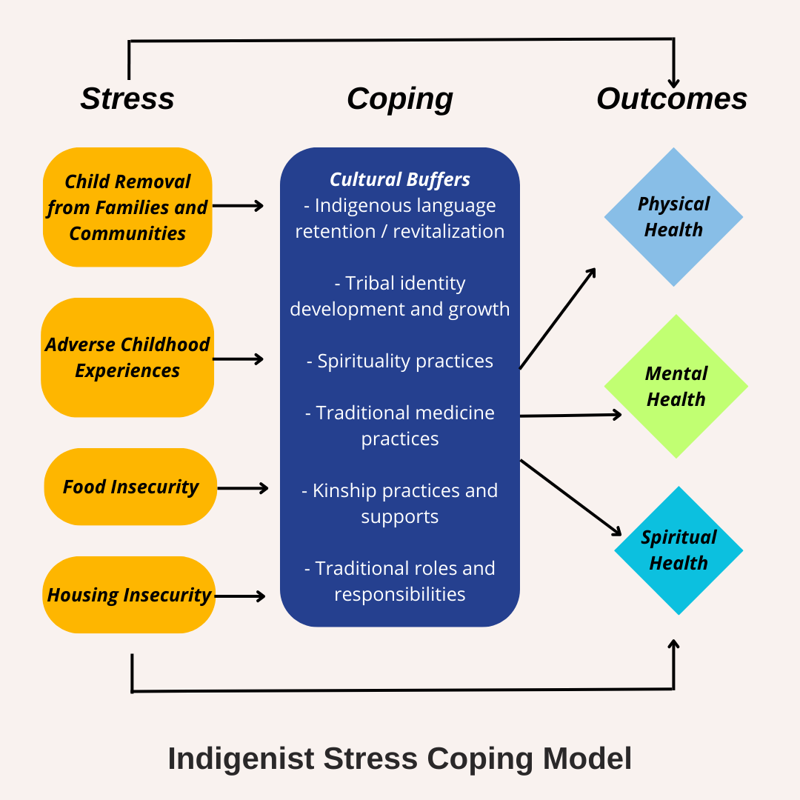
Indigenous Stress Coping Model
Figure 1: Sample Indigenist Stress Coping Model
Few health behavior models are developed from Indigenous worldviews, beliefs, knowledges, and lived experiences.
The Indigenist Stress Coping Model (right) is the first model to include American Indian and Alaska Native cultural connectedness as a buffer for major stress.
(Walters et al., 2002).

Slide 7
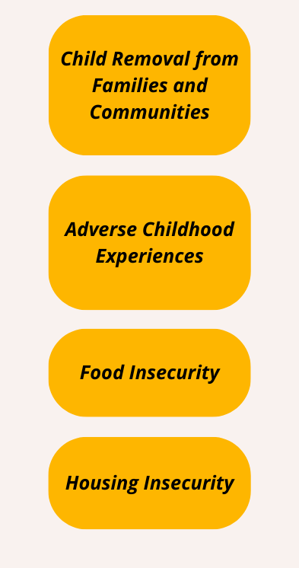
Indigenous Stressors Domain
From the Indigenist Stress Coping Model, we chose four examples of stressors that have been documented among American Indian and Alaska Native communities for a variety of reasons.
Boarding Schools resulted in removal of children from reservation communities (Zephier et al., 2020). American Indian and Alaska Native children continue to be removed from their home communities at disproportionately high rates through the child welfare system (Limb et al., 2024).
What are stressors present in your community?

Slide 8
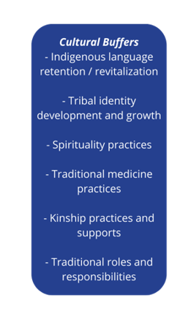
Indigenous Coping Domain
From the Indigenist Stress Coping Model, we chose six examples of coping strategies that have been documented among American Indian and Alaska Native communities.
First Nation communities in Canada that have the highest levels of language retention also report lower levels of suicidality (Hallett et al., 2007). American Indian and Alaska Native Tribal college students who report high levels of instrumental social support also report lower levels of depression and anxiety (Parker et al., 2020).
What coping strategies are present in your community?

Slide 9
Summary Checkpoint
The content and activities of this module were designed for your team to:
Build and maintain trust and connections
Describe shared community health beliefs and behaviors
Map pathways and strategies for health and well-being
Describe social determinants of health that create the conditions in these pathways

Slide 10
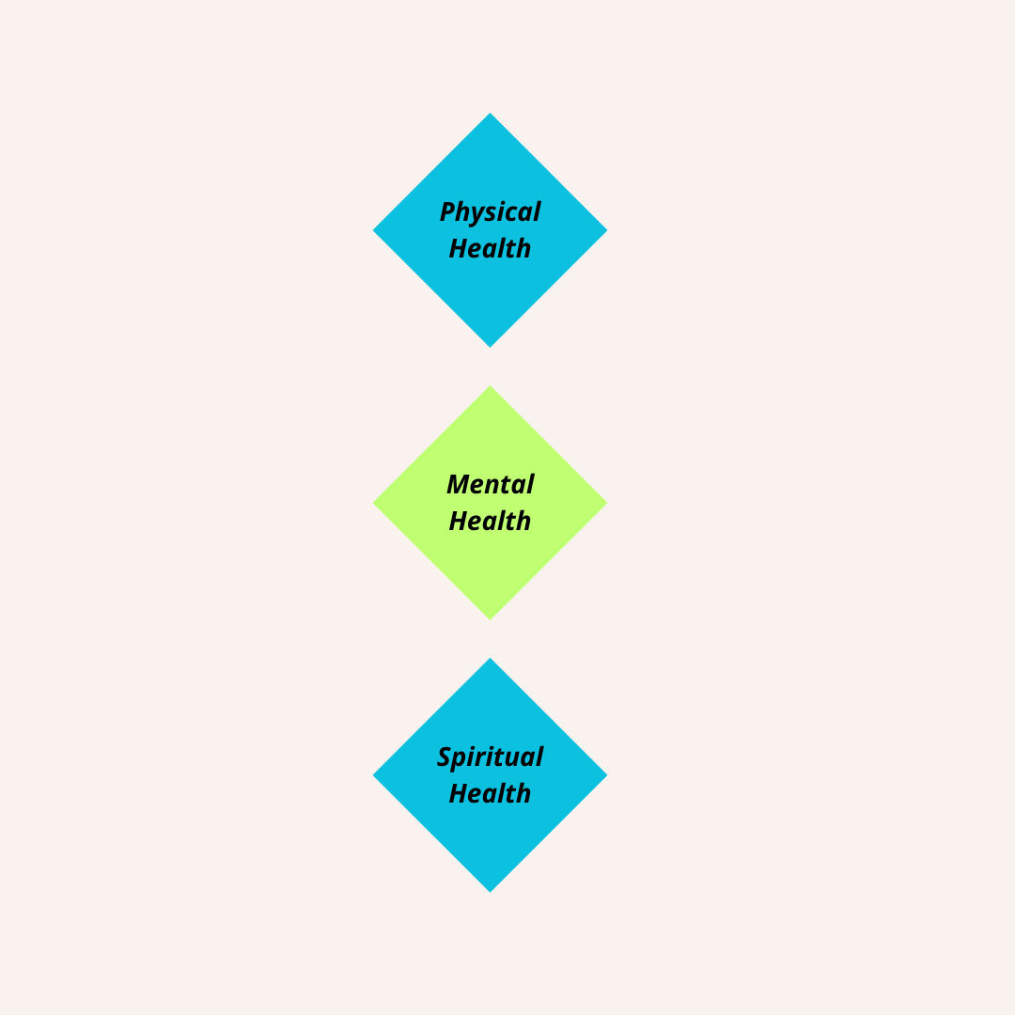
Health Outcomes
From the Indigenist Stress Coping Model, we identified three broad types of health outcomes.
Physical health refers to wellness across the systems within our body, including the absence of disease. Mental health refers to emotional well-being, including the ability to manage strong emotions and cope with stress and hardship. Spiritual health refers to connection to the Creator, the world around us, and other aspects of tribal belief systems.
What types of health outcomes are of interest in your community?

Slide 11
Applying Models and Identifying Social Determinants
The Maawaji' idi-oog Mino-ayaawin (Gathering for Health) project 2013-2015 was a community-based participatory research collaboration between the University of Minnesota and five American Indian communities (Brockie et al., 2018).
Adults with type 2 diabetes were asked questions about their experience with adverse childhood experiences (ACEs), participation in spiritual and connectedness activities, and perceptions of overall health.
The study found cultural and familial support were
Connected to better health
Mitigated the harms of ACEs

Slide 12
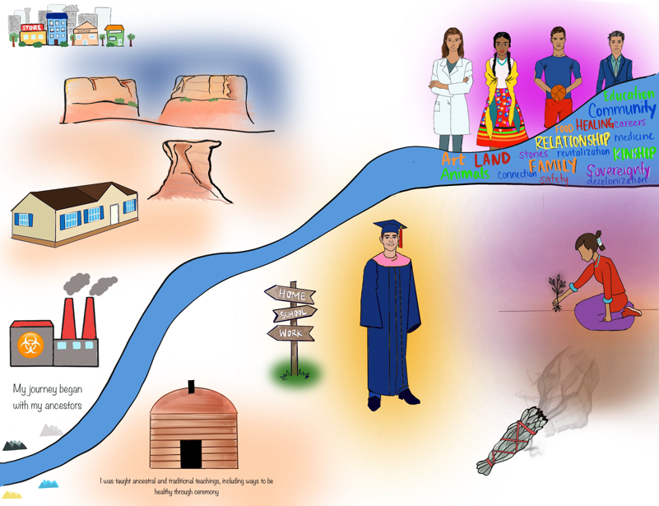
Our Stories, Our Journeys – An Adapted River of Life Activity
Our Stories, Our Journeys is a two-part activity using metaphor and storywork. It is an adapted River of Life activity.*
Part 1 is a personal journey of health and wellness
Reflect on own experiences allowing opportunity for introspection to identify and examine values and beliefs that inform your worldview
Reflect on community influences on your health and well-being
Part 2 is a group journey to identify the community themes for health and wellness
Share out story and journey of health and wellness
Identify factors that promote or inhibit health
*(Brown et al., 2019; Parker et al., 2020)
Drawing: D. Largo, 2022

Slide 13

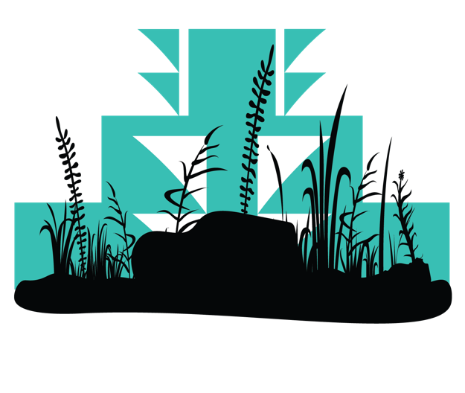
Activity – Part 1: Create Personal Journey
Use Our Stories, Our Journeys activity to reflect on your personal, individual journey for health and well-being.
Consider your surroundings and influences on your behavior and choices
Step 1: Using a blank sheet of paper, draw a river winding from the lower left corner of the page to the upper right corner of the page. Label the left “Beginning” and the right “Present.”
Step 2: River is a metaphor for your life experiences: Where do you find yourself presently, with regard to your health and wellness? What are some important moments that led you to where you are today?
Step 3: Label your river with symbols (islands, bridges, waterfalls) to represent major life events. Consider the places you have lived, the relationships that have been most impactful to you, and external factors that have helped shape the course of your journey.
Step 4: Along the side of the river, consider adding moments that were difficult or affirming for your life. Think about values, community context, and connection to people, land, and the environment.
Refer to "Module I, Part 1" worksheet

Slide 14
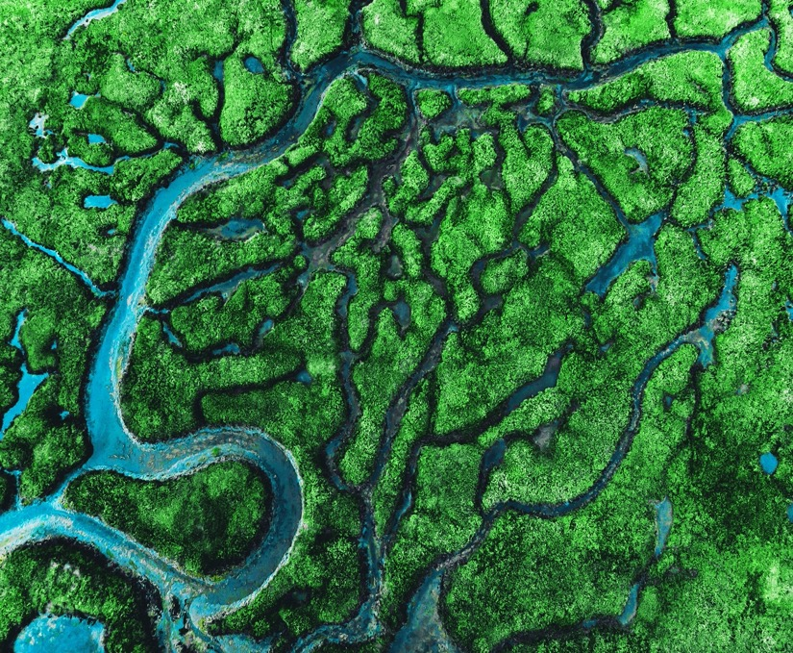
Reflection Questions– Part 1 (cont.)
After you are done creating your personal journey, please take 5-10 minutes to reflect.
Reflection Questions:
What values or teachings do you carry with you from your culture? How were they formed over your journey?
How do your values influence choices you make about your health and wellness?
What relationships have been instrumental to your life journey?
What outside influences impact your health?
How would you relate what you see in your river to the work you do with communities?

Slide 15

Activity – Part 2: Identify Common Themes for Health and Wellness
Part 2:
A. Sharing Our Stories images for group activities (one of multiple suggestions in handout)
Step 1: Post your image on the wall or other location in the room.
Step 2: Respond to reflection questions with post-its (1-2 words) & place them on/next to the image.
Step 3: Everyone will examine the images & responses during a 15-minute "gallery walk"
Step 4: Facilitate share out to identify common themes or values, principles, and relationships that describe the group ideas or perceptions of being healthy and well
Reflection questions:
Refer to the handout for detailed questions
Refer to Module I,
Part 2 – A worksheet

Slide 16
Activity – Part 2: Identify Common Themes for Health and Wellness
Part 2:
B. Identify community themes for health and wellness from
Our Stories, Our Journeys images
Step 1: Returning to the Trauma Coping Diagram
Step 2: Gallery Walk the images with post-its for 15 minutes
Step 3: Put 1-2 words for the types of health outcomes* depicted in the images
Step 4: Gather those post-its and put them in groups
Step 5: Review them for discussion of the groups
Discussion:
What are the shared health outcomes?
What are the influencers or factors that impact that health outcome? Focus on non-medical and non-individual behavior factors
What are the coping strategies presented?
*Health outcomes refer to spiritual, mental, and physical, as understood by your community/culture
Refer to Module I,
Part 2 – B worksheet

Slide 17
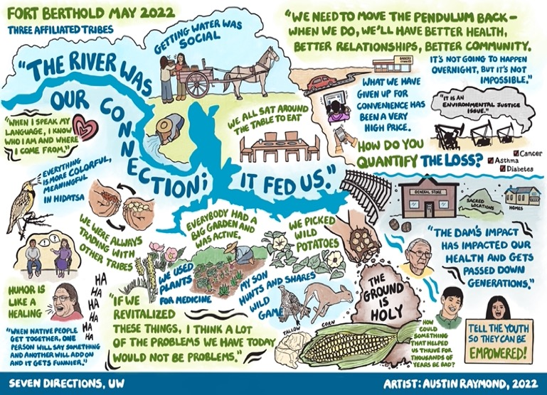
Activity – Part 2: Identify Common Themes
Part 2​
C. Create an image for the community
​
Step 1: Complete individual Our Stories, Our Journeys activity and reflect on the questions​
Step 2: Bring reflections and images (optional) to group meeting​
Step 3: Share out images and reflections (optional)​
Step 4: Share stories about the community health priorities, ensuring everyone is welcome and has a chance to share their stories growing up, living, and aspiration for community health and wellness.
Step 5: Invite a graphic notetaker or record and send for graphic image making (refer to image on right) ​
Step 6: Identify influences from individual to federal, historic and contemporary, on the conditions in which community members are living, praying, nurturing their children and relatives, and working.
Alternative Activity:
Refer to Module I,
Part 2 – C worksheet
Photo Caption: Seven Directions, UW (Raymond, 2022)

Slide 18
Post-Module Reflection
What were your thoughts about participating in the Our Stories, Our Journeys (adapted River of Life) exercise?
How has your perspective shifted AFTER this module, if at all?
How will you apply this information to your current work?
Can you identify some things you will do differently after participating in this module?

Slide 19

Summary
Module I provided an opportunity to reflect, learn, and share individual and collective health beliefs and behaviors for wellness.
The concepts and activities lay the foundation for identifying determinants of health from an Indigenous perspective and lived experience.
Module II will provide a definition of the Social Determinants of Health, offer ways to identify and describe them, and explore their impact on health and well-being within American Indian and Alaska Native communities.

Slide 20
Bibliography
Brockie, T. N., Elm, J. H., & Walls, M. L. (2018). Examining protective and buffering associations between sociocultural factors and adverse childhood experiences among American Indian adults with type 2 diabetes: a quantitative, community-based participatory research approach. BMJ open, 8(9), e022265.
Brown, M. & Duenas, A. (2019). A medical science educator’s guide to selecting a research paradigm: Building a basis for better research. Medical Science Educator, 30, 545-553
Hallett, D., Chandler, M. J., & Lalonde, C. E. (2007). Aboriginal language knowledge and youth suicide. Cognitive Development, 22(3), 392–399. https://doi.org/10.1016/j.cogdev.2007.02.001
Limb GE, Chance T, Brown EF. An empirical examination of the Indian Child Welfare Act and its impact on cultural and familial preservation for American Indian children. Child Abuse Negl. 2004 Dec;28(12):1279-89. https://doi.org/10.1016/j.chiabu.2004.06.012. PMID: 15607770.
Parker, M., Wallerstein, N., Duran, B., Magarati, M., Burgess, E., Sanchez-Youngman, S., Boursaw, B., Heffernan, A., Garoutte, J., & Koegel, P. (2020). Engage for equity: Development of community-based participatory research tools. Health Education & Behavior, 47(3), 359–371. https://doi.org/10.1177/1090198120921188
Walters, K. L., & Simoni, J. M. (2002). Reconceptualizing Native women’s health: An “Indigenist” stress-coping model. American Journal of Public Health (1971), 92(4), 520–524. https://doi.org/10.2105/AJPH.92.4.520
Zephier Olson MD, Dombrowski K. A Systematic Review of Indian Boarding Schools and Attachment in the Context of Substance Use Studies of Native Americans. J Racial Ethn Health Disparities. 2020 Feb;7(1):62-71. https://doi.org/10.1007/s40615-019-00634-4 Epub 2019 Aug 26. PMID: 31452147.

Slide 21
Citation
Parker, M., Largo, D., Benally, T., Oré, C.E. (2023). Indigenous social determinants of health: training modules. University of Washington: Seven Directions. [link to website pdf]

Slide 22

Acknowledgments
This project is supported by the Centers for Disease Control and Prevention (CDC) of the U.S. Department of Health and Human Services (HHS) as part of a financial assistance award to the National Network of Public Health Institutes (NNPHI) totaling $375,000 with 100 percent funded by CDC/HHS (Award #s 1 NU38OT000303-01-00, 5 NU38OT000303-04-00, and 5 NU38OT000303-03-00). NNPHI has collaborated with Seven Directions at the University of Washington, and the CDC’s Office of Tribal Affairs and Strategic Alliances, on this effort.

